Slide 1
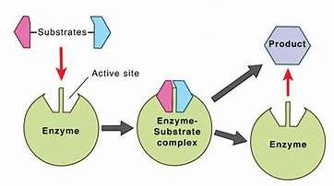
Enzyme function
AEHBY ATAR Human Biology

Slide 2
Review
What is a monomer?
Which biomolecule is a reactant for cellular respiration?
Which cell components are made of proteins?
Which cell components are made of lipids?
Summarise the elements contained in each class of biomolecules.
Explain the difference between a vitamin and a mineral.

Slide 3
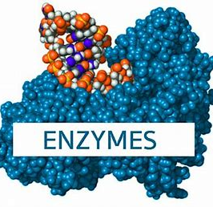
Learning Intentions
enzyme function can be affected by factors including pH, temperature, presence of inhibitors and co-factors, and the concentration of reactants and products

Slide 4
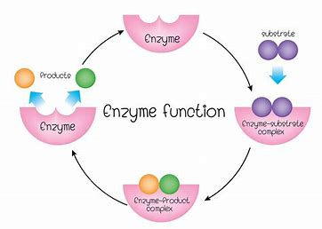
Success Criteria
List the factors that affect enzyme function
Explain how and why each factor affects enzymes
Compare graphs of enzyme activity

Slide 5
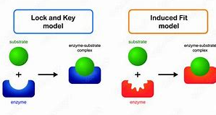
Enzymes
For both the lock and key and induced fit models, enzyme shape affects the ability of the substrate to bind to the active site.

Slide 6
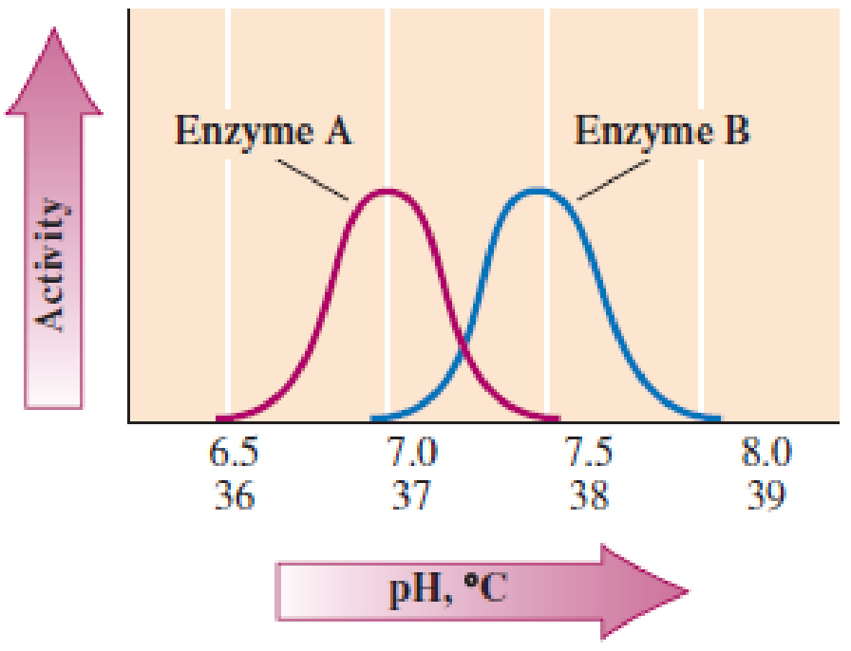
pH
how acidic or basic
each enzyme has an optimal pH range
changing pH will change shape and therefore ability to function

Slide 7
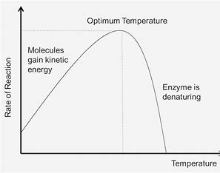
Temperature
enzymes are made of proteins
if it is too cold, the reactant molecules move too slowly to react
proteins denature if the temperature is too high

Slide 8
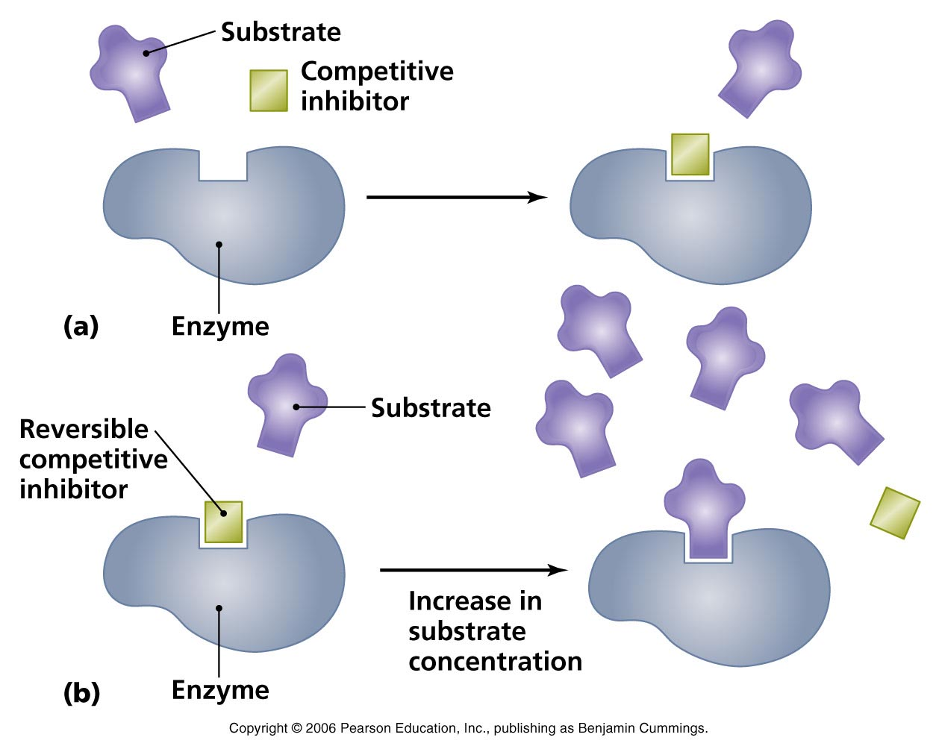
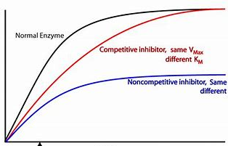
Inhibitors
block enzyme function either by binding to the active site or by binding to another location which distorts the shape of the active site
may bind reversibly or permanently
specific to particular enzymes

Slide 9
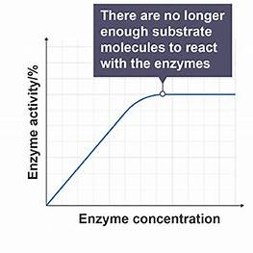
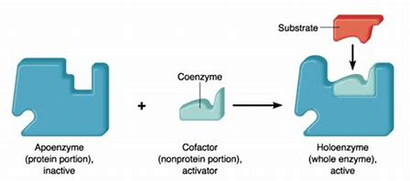
Cofactors and coenzymes
Cofactors are non-protein components of an enzyme that activate the enzyme
Coenzymes are enzymes that work together

Slide 10
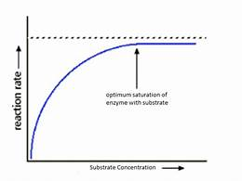
Reactant and product concentration
Increasing substrate concentration will increase reaction rate, up to the point of enzyme saturation.
Increasing product concentration will decrease reaction rate.

Slide 11
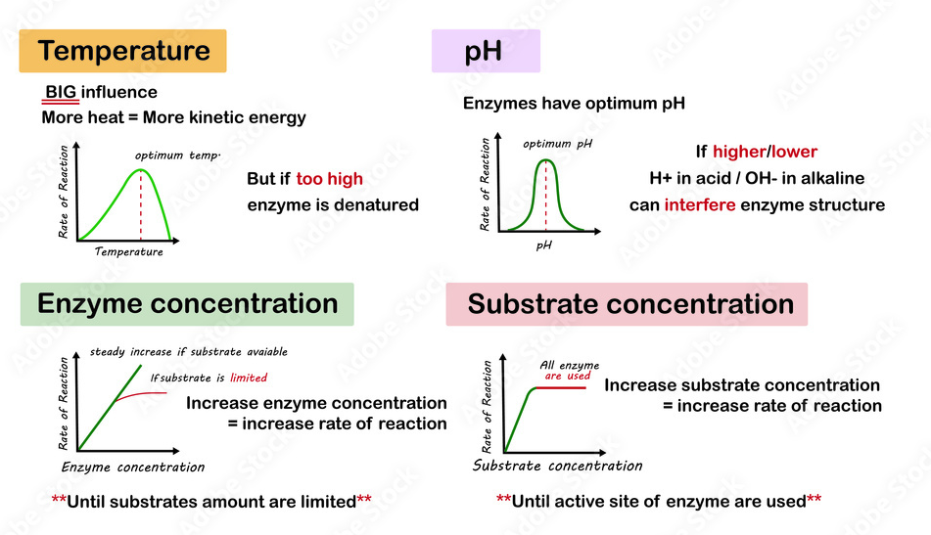

Slide 12
Questions
Without enzymes, draw a graph to show reaction rate vs temperature
Why can cells not function at higher temperature?
What does denaturation mean?
How are enzyme concentration and substrate concentration graphs related?
Explain how and why enzyme activity graphs for pH and temperature are different.

